Slide 1


WHATSAPP CHATS ANALYZER
USING MACHINE LEARNING
Name – Satyam Parashar
Course - B TECH CSE 4th Sem
Class Roll No – 54
Roll Number – 2119138
Student Id – 21011740
Subject – Mini Project

Slide 2

INTRODUCTION:
Unlocking Insights: Analyzing WhatsApp Chats with Machine Learning
WhatsApp is one of the most popular messaging Apps worldwide. This presentation explores how machine learning algorithms can be used to extract valuable insights from WhatsApp chats. By analyzing patterns, sentiment, and user behavior, we can uncover hidden trends and make data-driven decisions.

Slide 3

Understanding Machine Learning:
Machine Learning is a branch of artificial intelligence that enables computer systems to learn and improve from experience without explicit programming. Gain a comprehensive understanding of the key concept and techniques used in ML, including supervised and unsupervised learning, natural language processing, and text classification

Slide 4
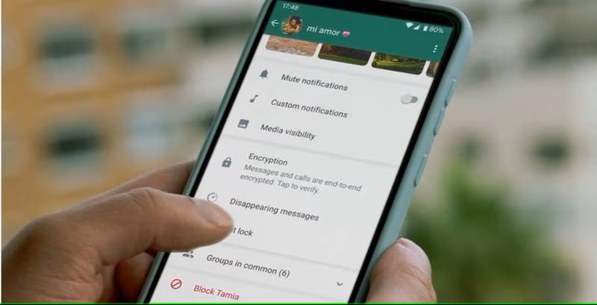
Whatsapp Chat Data :
Understanding the Dataset: Types of data and their significance WhatsApp chat data usually includes text messages, timestamps, and sender information. It can be further enriched with metadata like emojis, multimedia, and group interaction. Analyzing these components provides a comprehensive view of conversation, enabling us to identify key contributors and track communication patterns.

Slide 5
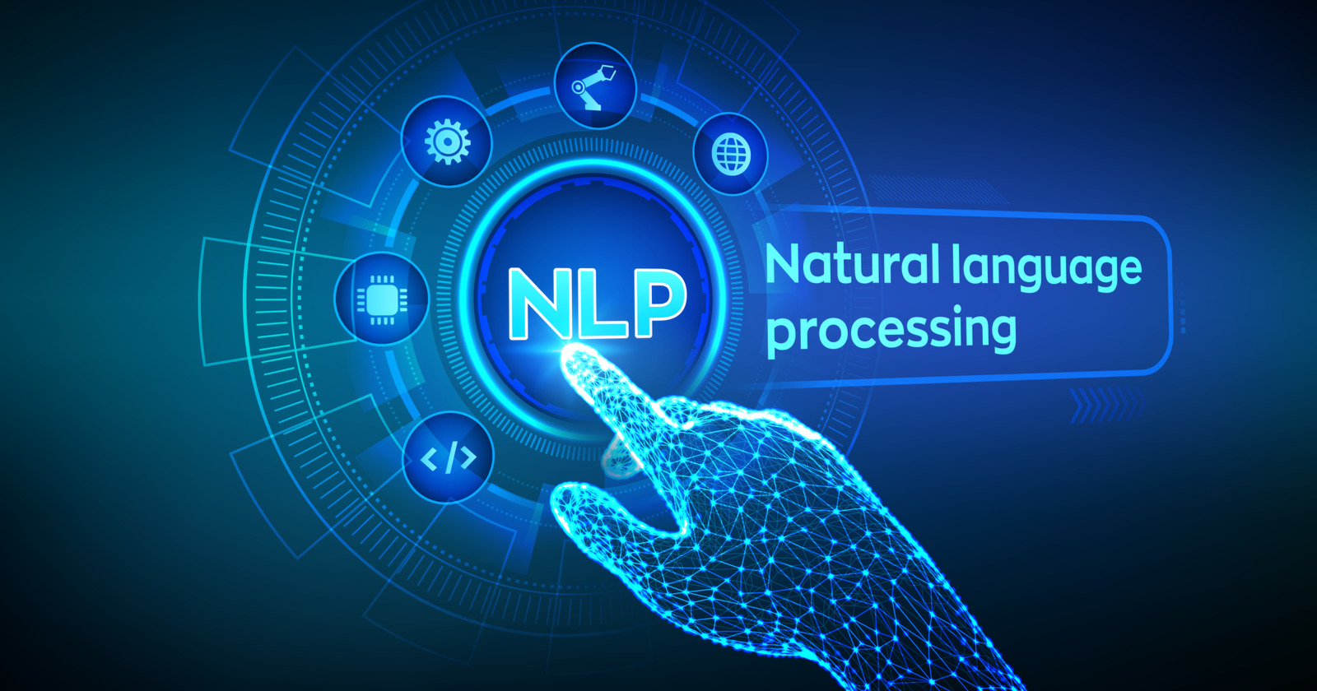
Extracting Insight with Natural Language Processing
Natural Language Processing (NLP)
Plays a vital role in analyzing WhatsApp
Chats. Explore how NLP techniques, such as tokenization, part-of-speech tagging, and named entity recognition, enable us to extract meaningful information from textual data. Discover how these insights can be utilized for sentiment analysis, topic modeling, and user profiling.

Slide 6

Machine Learning Models for WhatsApp chat analysis
Learn about the machine learning models commonly employed for WhatsApp chat analysis. From bag-of-words and tf-idf models to word embeddings and recurrent neural networks(RNNs), we will explore the strengths and limitations of each approach. Understand how these models can be trained to classify messages, detect spam, and identify key themes.

Slide 7

Preprocessing Techniques
Cleaning and Formatting:
Preparing Whatsapp chat data for analysis before applying machine learning algorithms, and preprocessing is crucial. Techniques include removing irrelevant messages, handling missing data, tokenizing text, and normalizing timestamps. By cleaning and formatting the data, we ensure accurate and reliable results in subsequent analysis.

Slide 8
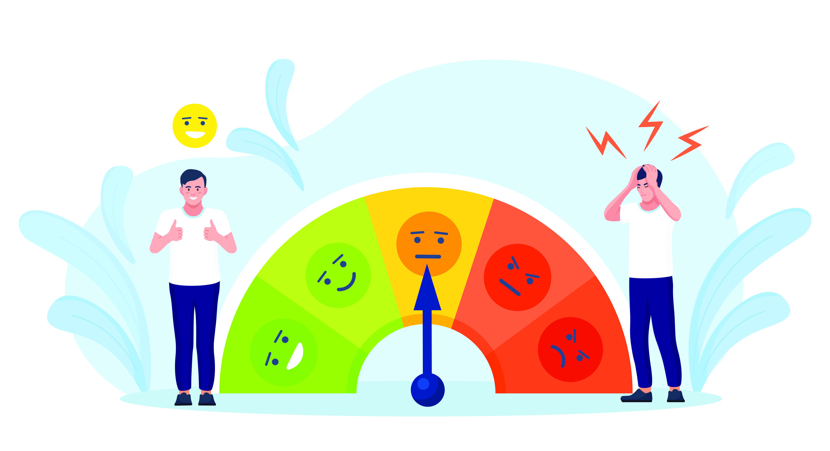
Sentiments Analysis:
Unveiling Emotions:
Analyzing sentiments in WhatsApp chats sentiments analysis helps us understand the emotional tone of the conversation. By classifying messages as positive, negative, or neutral, we can gauge user satisfaction, identify potential conflicts, and measure overall sentiment trends over time. This information can be invaluable for businesses and researchers alike.

Slide 9

Topic Modelling:
Discovering Themes:
Extracting topics from WhatsApp chats
Topic modeling algorithms like Latent Dirichlet
Allocation (LOA) enables us to identify prevalent themes within the chat data. By clustering related messages, we can uncover common discussion topics, track their popularity, and gain insights into the interests and preferences of the chat participants.

Slide 10
Conclusion
Unlocking Insights
Leveraging machine learning for WhatsApp chat and lysis
Machine learning techniques offer powerful tools to extract valuable insights from WhatsApp chats. By analyzing sentiment, identifying key contributors, and discovering common topics, we can make data-driven decisions, improve user experiences, and gain a deeper understanding of the dynamics within WhatsApp conversations.

Slide 11
THANK YOU

